Slide 1
TDD with Python
Chapter 01
CIDM6330
Spring 2020

Slide 2
What? …are we doing?
Python:
Easy to learn and will carry you to mastery
Lingua Franca of Data Science/Intelligence/Analytics/Whathaveyou
Modern, powerful, and elegant
HTML/CSS/JS
https://www.w3schools.com/ - seriously
Django – an MVC framework for web applications
CAVEAT – we are using 1.11

Slide 3
What? …do I need?
Firefox (works on all platforms)
Git
Editor
Good reference tutorial - http://rogerdudler.github.io/git-guide/
Virtualenv
Geckodriver
Works with Firefox
Take care of Percival’s instructions regarding Windows

Slide 4
Virtualenv and Django
Commands
Activate and Deactivate
Take care of windows-specific instructions
Take care of the common errors identified by the author
Install Django and Selenium
Follow the author’s website: http://www.obeythetestinggoat.com/
He has videos available as well that covers the entirety of part I (all I’ve assigned)
http://shop.oreilly.com/product/110000781.do?cmp=yt-prog-books-videos-product-promo_test_driven_development
It does cost money – its up to you

Slide 5
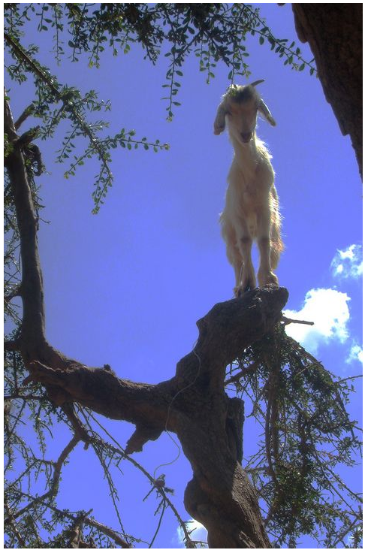
Until you Test, Nothing Exists
TDD is basically this:
Your design is the set of tests you specify
You literally start with all tests and no implementation
Your system works when the tests pass
The goat thing?
Perhaps just a bit of fun
However
It does emphasize methodical, bottom up, and step-wise design
Which is distinct from using high-order modeling tools like UML

Slide 6
So we make tests
We follow the steps…
We create a local git repo
And then a remote
And sally forth

